Slide 1

UML DIAGRAMS IN ANALYSIS
Notes:
‹#›

Slide 2
Requirements Elicitation
ACTIVITY DIAGRAMS BASICS

Slide 3
Flow Models
Every computer-based system is an
information transform ....
input
computer
based
system
output
Flow diagrams – Lots of these!
Dataflow diagrams
Petri Nets
IDEF0
Activity diagrams

Slide 4
ACTIVITY DIAGRAM ESSENTIALS
Activity diagrams describe the stepwise flow of activities and actions.
Main purpose:
model both organisational (i.e., workflows) and computational processes
identify candidate system use cases
through the examination of business workflows
model flow between (or within) use cases
identify pre- and post-conditions of use cases

Slide 5
WHAT IS AN ACTIVITY DIAGRAM?
An activity diagram in the use-case model can be used to capture the activities and actions performed in a use case.
It is essentially a flow chart, showing flow of control from one activity or action to another.
Activity 2
Activity 1
Activity 3

Slide 6
ACTIVITY DIAGRAM ESSENTIALS
Activity diagrams describe the stepwise flow of activities and actions.
Main elements:
actions / activities: represent the executable steps
transitions: represent the control flow
split / merge: represent decisions
fork / join: represent concurrency
swim lanes: structure the control flow

Slide 7
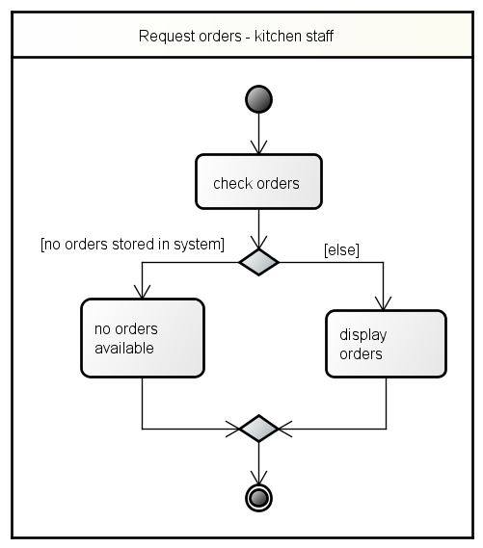
ACTIVITY DIAGRAM – BASIC STRUCTURE
Origin:
flow charts
program execution plans
Activities:
sequence of actions
transitions immediate (triggerless)
exit at final state

Slide 8
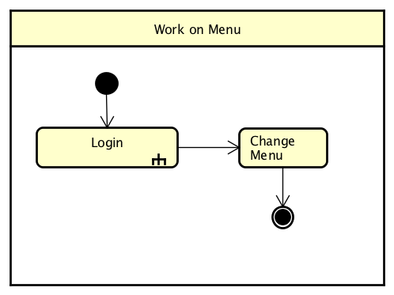
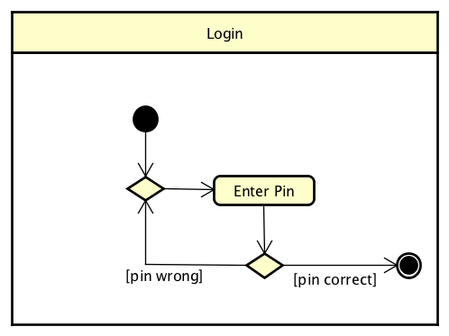
ACTIVITY DIAGRAM – ACTIONS VS. ACTIVITIES
actions:
executable atomic computation in the control flow
cannot be decomposed
activities:
also executable units in the control flow but non-atomic
can be decomposed
can be represented by a separate activity diagram
action
activity

Slide 9
ACTIVITY DIAGRAM – DECISIONS
decision node:
only one branch can execute
use mutually exclusive conditions
[else] possible
merge node:
reunite alternative control flows
decision node
merge node

Slide 10
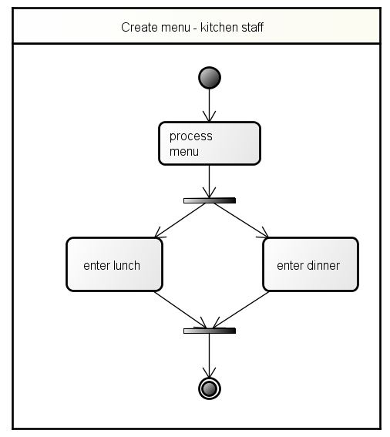
ACTIVITY DIAGRAM – CONCURRENCY
split (fork):
B and C only start after A
B and C mutually independent
both branches execute
synchronization (join):
D happens only after B and C
independent control flows are synchronized
A
fork
B
C
join
D

Slide 11
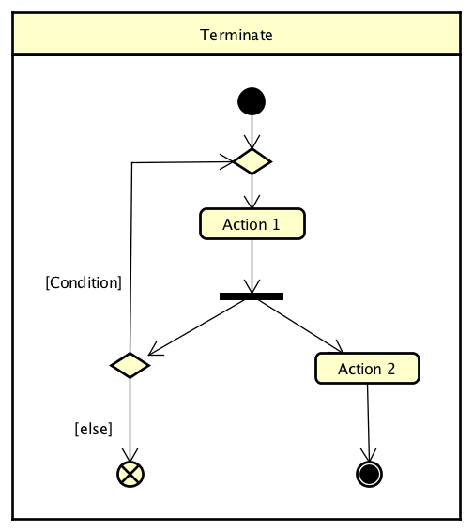
ACTIVITY DIAGRAM – TERMINATION NODES
activity final:
entire activity is ended
including other flows
flow final:
only current flow is ended
other flows can continue
activity final
flow final

Slide 12
EXAMPLE: ACTIVITY DIAGRAM
Select Course
[ delete course ]
Delete Course
[ add course ]
Check
Check
Schedule
Pre-requisites
[ checks completed ]
[ checks failed ]
Assign to
Resolve
Course
Conflicts
Update
Schedule

Slide 13
MAPPING WHO DOES WHAT TO WHOM
Examples so far show us what actions happen
But “WHO” does each action and “WHEN”?
Swimlanes
Partition activities according to who does them
Who can be actors, system components, whatever
When is indicated top-to-bottom (like a sequence diagram) or left-to-right
To Whom?
Activity diagrams can show relationships to objects that are affected by actions

Slide 14
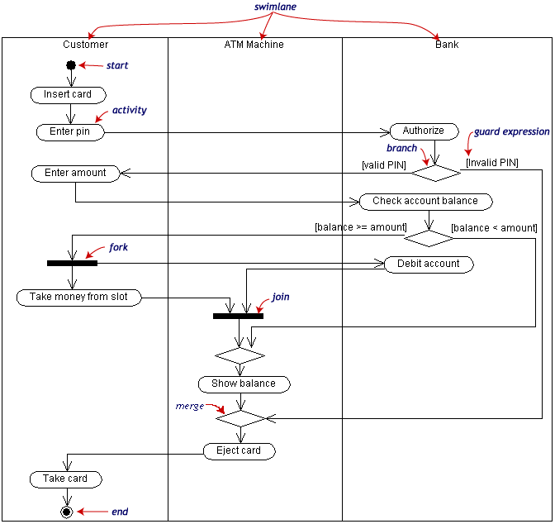
Requirements Elicitation

Slide 15
HOW DO YOU DERIVE SWIMLANES?
Swimlanes add an analysis step
You are assigning a responsibility to an actor
Note we did not say to an object - to an actor
How to?
Technique: Return to the UC main scenario
Outline the steps based on who does them

Slide 16
ACTIVITY DIAGRAM SUMMARY
Pros:
Map use case scenarios directly on to actions
Most intuitive for most procedural programmers
Includes constructs concurrency and task assignment
Includes constructs for top down decomposition (activity frames)
Cons:
Some confusion of the relationship between activity diagrams and statecharts
Some changes in terminology from 1.5 to 2.0
Relatively poor tool support

